Slide 1
BHEEMANNA KHANDRE INSTITUTE OF TECHNOLOGY BHALKI
DEPARTMENT OF ELECTRONICS &COMMUNICATION
ENGNEERING

Slide 2
Seminar on
“NEXT GENERATION FREE SPACE OPTICS SYSTEM IN WIRELESS COMMUNICATION TECHNLOGY”
Under the guidance of
Anandkumar
Presented by
Prof.Sanjeev Gogga

Slide 3
Presentation Overview
introduction
Need for FSO
Historical over view
Major subsystem
Why free space optics
Wave length issues
Challenges
Advantages & disadvantages
The Future of FSO
conclusion

Slide 4
INTRODUCTION
FSO is a wireless technology that transmit data via laser beams
FSO uses a light to transmit data between buildings that have a clear line of sight(LOS)
Currently it can allow up to 2.5gbps of data rate but can increases to 10gbps using WDM
FSO is based on connectivity between two stations consisting of optical transcivers with a laser Tx and laser RX to provide full duplex communication
Free space link behave a similarly to a fiber optic system

Slide 5
Need for FSO
Fso can send large amount of data(around 2.5 gbps of data)
No need to get licence,the spectrum used is an unlicensed world wide
Can transmit data at distance around 8km(almost 4 and half miles)
The cost is often less than that of using fiber optic cables
Fso system can be installed quickly(in days)
Because it used light there is no RF interference

Slide 6
Historical over view
Developed in late 60‘s by a German scientist Dr.Erhard Kube also known ‘Father of FSO technology‘
It has been used by military and NASA
The aim of its providing secure data and voice transmission in military researchers
Recently entered into the field of Telecommunications due to its fast accessing technology

Slide 7
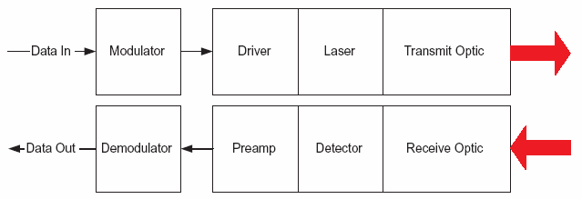
Major subsystem

Slide 8

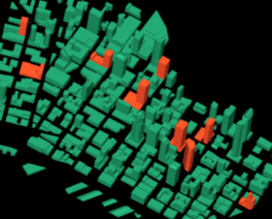
Why Free Space Optics (FSO)? The “Last Mile” Bottleneck Problem
Wide Area Networks between major cities are extremely fast
Fiber based
>2.5 Gbps
Local Area Networks in buildings are also fast
>100Mbps
The connections in between are typically a lot slower
0.3-1.5 Mbps
Only about 5% of commercial buildings are lit with fiber

Slide 9
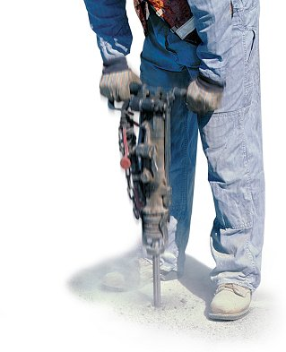
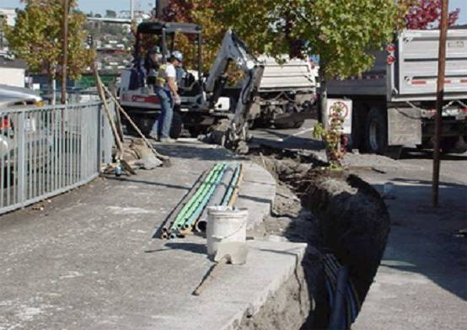
Why Free Space Optics? Why Not Just Bury More Fiber?
Cost
Rights of Way
Permits
Trenching
Time
With FSO, especially through the window, no permits, no digging, no fees

Slide 10
Why Free Space Optics? How Fiber Optic Cable Works
Glass Fiber Strands
Light Source
Detector
Detector
Light Source
Network Device
Network Device
Pulses of light communicate the data
“ON” = 1
“OFF = 0
Capable of more than 40 Gbps
>7 CDs a second

Slide 11




Why Free Space Optics? How FSO Works
3
A receiver at the other end of the link collects the light using lenses and/or mirrors
2
Transmitter projects the carefully aimed light pulses into the air
5
Reverse direction data transported the same way.
Full duplex
1
Network traffic converted into pulses of invisible light representing 1’s and 0’s
4
Received signal converted back into fiber or copper and connected to the network
Anything that can be done in fiber can be done with FSO

Slide 12
Why Free Space Optics? Transmission security
Beams only a few meters in diameter at a kilometer
Allows a very close spacing of links without interference
No side lobes
Highly secure
Efficient use of energy
Ranges of 20m to more than 8km possible

Slide 13
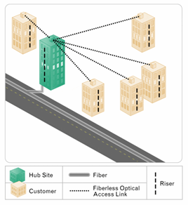
Why Free Space Optics? The FSO “Value Proposition”
No interference
Unlicensed
Easy to install
Through the window (or from the rooftop)
No trenching, no permits
Fiber-like data rates
Many deployment options

Slide 14
Wave length issues
Chosen Wavelength:
780-850 nm (353-385 THz)
1520-1600 nm (188-197 THz)
Reason:
Low attenuation
Implementation and safety

Slide 15

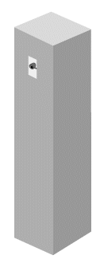

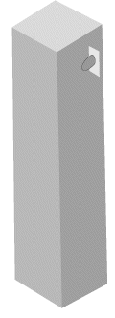
Challenges Environmental factors
Sunlight
Window
Attenuation
Fog
Building Motion
Scintillation
Alignment
Range
Obstructions
Low Clouds
Each of these factors can “attenuate” (reduce) the signal. However, there are ways to mitigate each environmental factor.

Slide 16
challenges
physical obstructions: Flying birds can temporarily block a single beam, but this tends to cause only short interruptions, and transmissions are easily and automatically resumed.
Safety: To those unfamiliar with FSO, safety is often a concern because the technology uses lasers for transmission
Absorption: Absorption occurs when suspended water molecules in the terrestrial atmosphere extinguish photons. This causes a decrease in the power density (attenuation) of the FSO beam and directly affects the availability of a system.

Slide 17
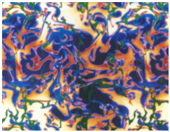
Challenges Scintillation
Beam spreading and wandering due to propagation through air pockets of varying temperature, density, and index of refraction.
Almost mutually exclusive with fog attenuation.
Results in increased error rate but not complete outage.

Slide 18
Challenges Building Motion – Thermal Expansion
Results from Seattle Deployment:
15% of buildings move more than 4 mrad
5% of buildings move more than 6 mrad
1% of buildings move more than 10 mrad

Slide 19
Advantages
Ease of deployment
License-free operation
High bit rates
Low bit error rates
Immunity to electromagnetic interference
Full duplex operation
Very secure due to the high directionality and narrowness of the beam(s)

Slide 20
Disadvantages
Beam dispersion
Atmospheric absorption
Rain
Fog (10..~100 dB/km attenuation)
Scintillation
Pollution / smog
If the sun goes exactly behind the transmitter, it can swamp the signal.

Slide 21
Future of FSO technology
FSO technology will evolve from just an alternative to the fiber optics into one of the most important access solutions.
Several future FSO applications are the cellular backhaul, where FSO is used to transfer voice and data between cellular base stations
Wi-Fi hotspots, where FSO and Wi-Fi work well together since FSO provides no interference
cable TV networks, where FSO is used to transfer the digital video data, and of course as redundant links for optical fiber networks, where FSO serves as the backup link.

Slide 22
conclusion
Fso technology will be good alternative for the fixed wireless broadband communications
It provides high bandwidth near to the optical fiber capacity,short-time installation and low cost
It can send higher data rates

Slide 23
References
The Free Space Optic Website (http://www.freespaceoptic.com)
The Components in Electronics Web Site (http://www.cieonline.co.uk)
Google Search
Wikipedia Search

Slide 24
Thank you

